Slide 1
Cover Ratio Maximization
Keming Li, 11612126

Slide 2
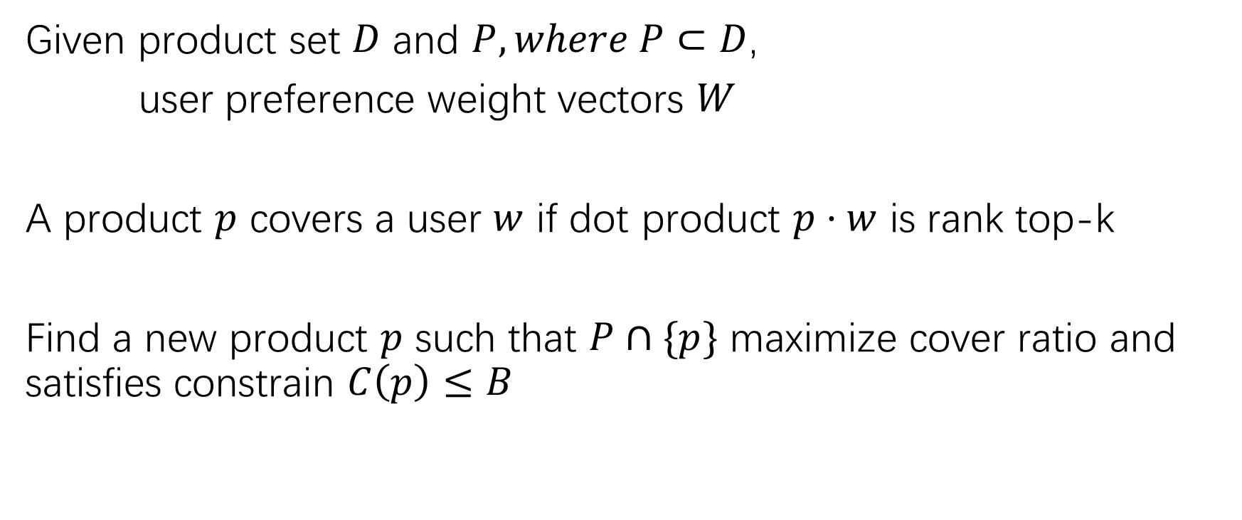
Problem review
Given product set $D$ and $P, where P⊂D$,
user preference weight vectors $W$
A product $p$ covers a user $w$ if dot product $p·w$ is rank top-k
Find a new product $p$ such that $P∩\{p\}$ maximize cover ratio and satisfies constrain $C\left(p\right)≤B$

Slide 3
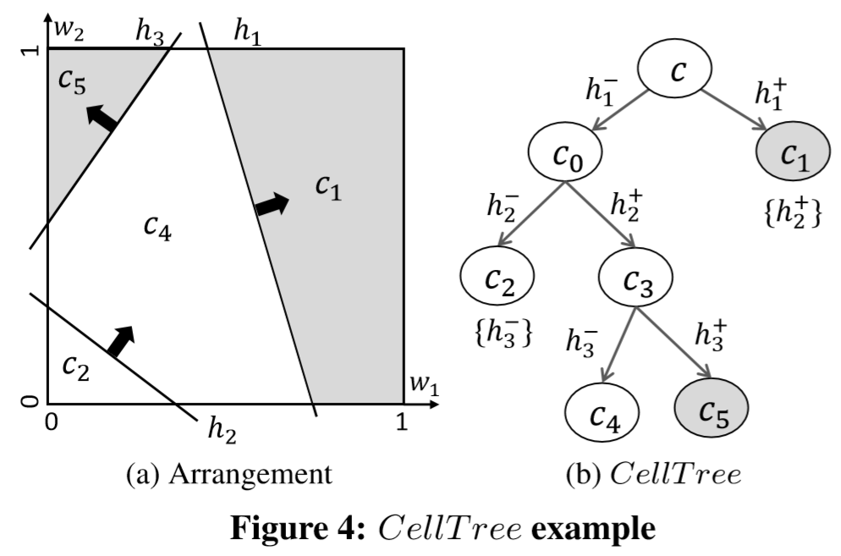
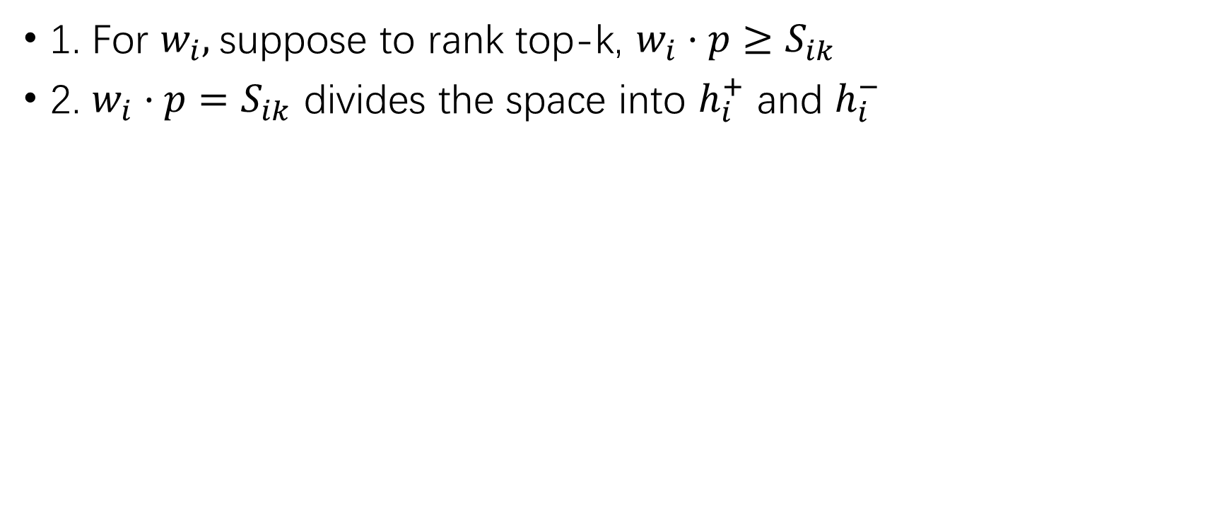
Solution review
1. For $w_{i},$suppose to rank top-k, $w_{i}·p≥S_{ik}$
2. $w_{i}·p=S_{ik}$ divides the space into $h_{i}^{+}$ and $h_{i}^{−}$

Slide 4
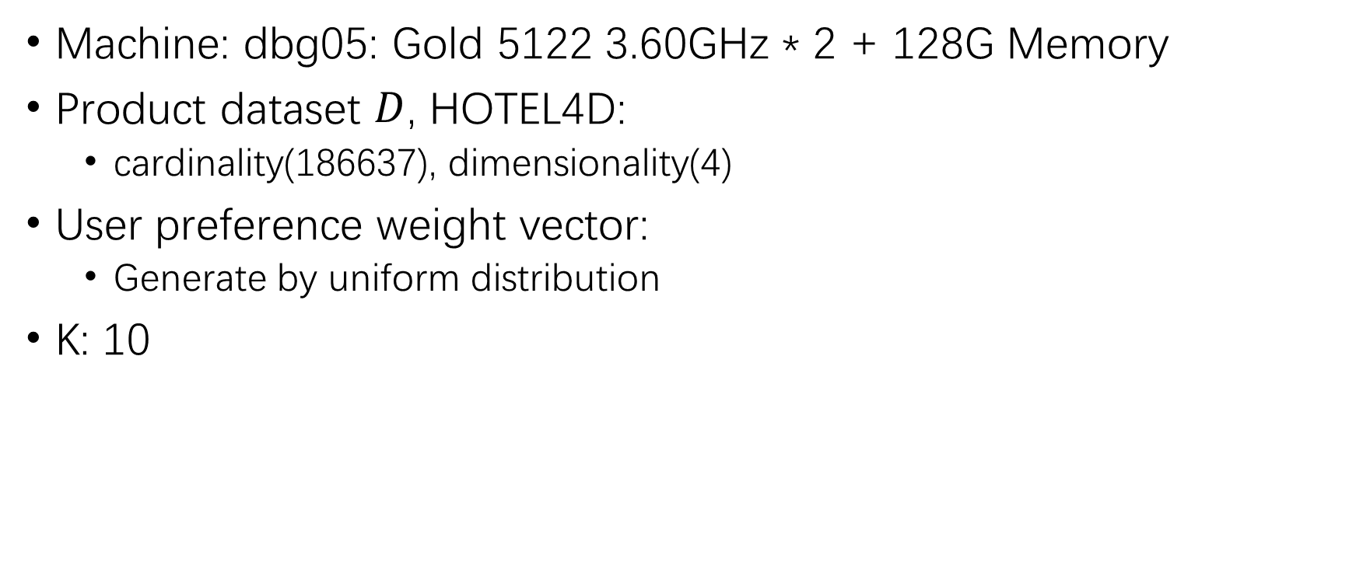
Experiment setting
Machine: dbg05: Gold 5122 3.60GHz * 2 + 128G Memory
Product dataset $D$, HOTEL4D:
  cardinality(186637), dimensionality(4)
User preference weight vector:
  Generate by uniform distribution
K: 10

Slide 5
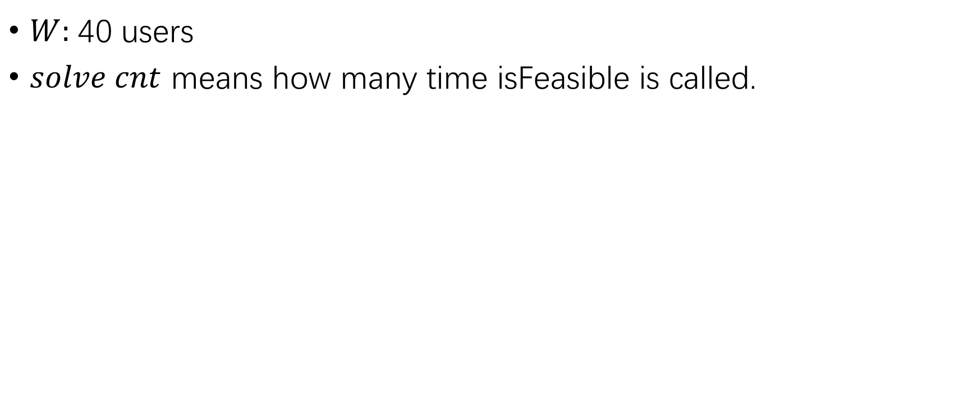
Exp1: isFeasible() in all nodes or leaf nodes
$W:$40 users
$solve cnt$ means how many time isFeasible is called.
All nodes |  |  |  | Leaf nodes
Time(sec) | Solve cnt | Cnt/time | Total time in CellTree | Time | Solve cnt | time/cnt | Total time in CellTree
94.710 | 482686 | 5096.462 | 95.320 | 106.800 | 490423 | 4591.975 | 107.290

Slide 6
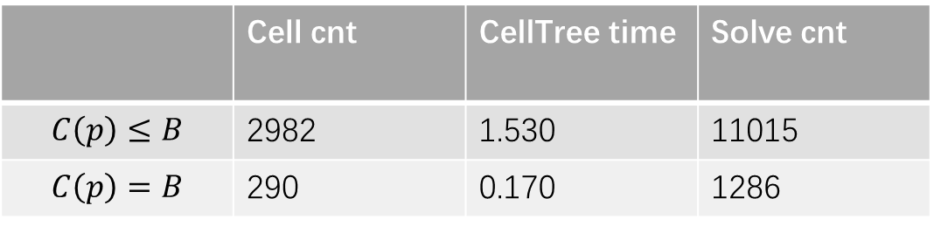
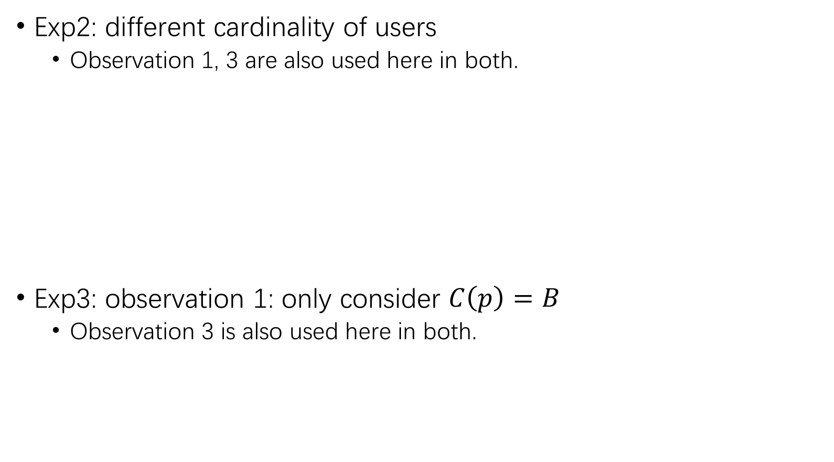
Exp2: different cardinality of users
  Observation 1, 3 are also used here in both.
Exp3: observation 1: only consider $C\left(p\right)=B$
  Observation 3 is also used here in both.
 | Pre time | CellTree time | Cell cnt | Solve cnt
Card(W)=100 | 7.09 | 0.17 | 290 | 1286
Card(W)=1000 | 69.780 | 56.990 | 64484 | 303369
Card(W)=10000 | 693.76 | ??? | 6.7M+ | ???
 | Cell cnt | CellTree time | Solve cnt
$$C\left(p\right)≤B$$ | 2982 | 1.530 | 11015
$$C\left(p\right)=B$$ | 290 | 0.170 | 1286

Slide 7
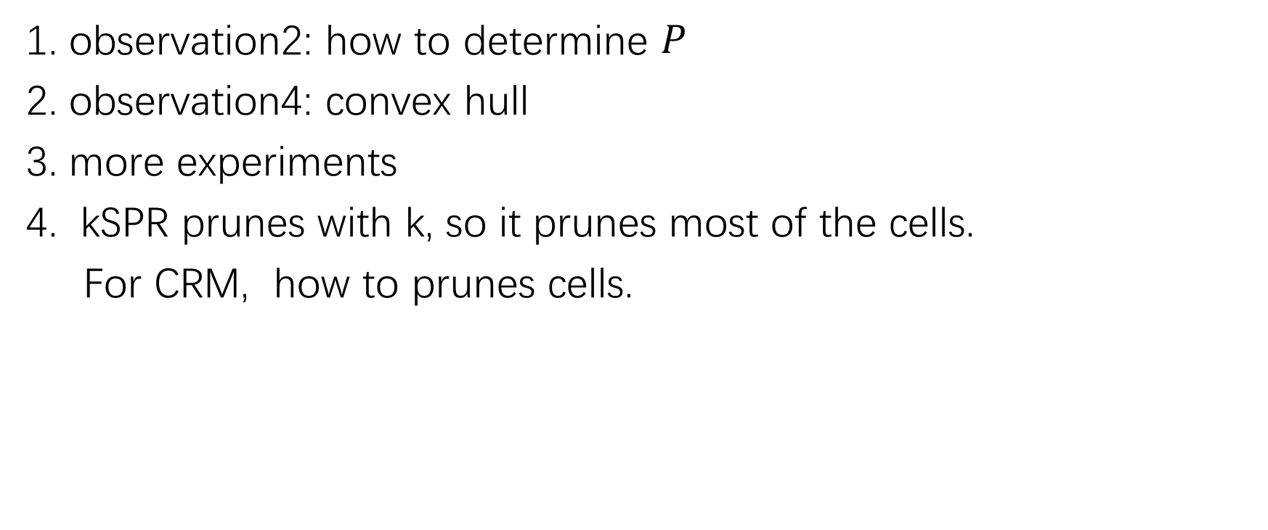
TODO
1. observation2: how to determine $P$
2. observation4: convex hull
3. more experiments
4. kSPR prunes with k, so it prunes most of the cells.
For CRM, how to prunes cells.

